Slide 1

Adversarial Evasion Attacks Analysis
BY- Maan Patel & vishw joshi
Guided by- Scientist Pooja Yadav

Slide 2
Abstract
An adversarial evasion attack in the context of image data is a type of attack on machine learning models, particularly those used in computer vision, where an attacker modifies the input images in subtle ways to deceive the model into making incorrect predictions or classifications. These modifications are often imperceptible to the human eye but can cause significant changes in the model's output.
These adversarial attacks are mainly classified into two types : 1) White Box Attacks
2) Black Box Attacks
In this project our aim was perform how different Black Box Attacks perform how it depends on different class of CNN based facial recognition model.

Slide 3
Brief Approach
For performing attacks we require a CNN based facial recognition model, so we fine-tunned a pre-trained model based on CNN architecture.
We choose Inception Resnet v1 pre-trained model and Cassia Web face 2 Dataset for fine-tunning.
Multiple Attacks were run on different class of this model, where confidence of prediction of this classes was greater than 0.99
As a results of these performing attacks we extract the dependency of attack’s success on the different classes of the facial recognition model, where classes have different number of images during training and validation

Slide 4
Model Preparation
Initially, we choose LWF (Labelled Faces in the Wild) and Inception Resnet v1 pre-trained model.
But we found model getting over fit due less number of images in data set and uneven image distribution of images across different classes in the dataset.
So, to overcome this we change the dataset to Cassia Web face 2 with 4,90,623 images of 10,572 people. Divided dataset in to 80/20 ratio of training and testing.
To achieve high accuracy of pre-trained model we performed two steps, first feature extraction in which original head (dense layers) was removed and our custom dense layers were added. All trainable parameters of convolutional layers were made “False”.
77% validation accuracy was achieved in feature extraction step.
Further in next step the some layers of convolutional layers were kept trainable to in the accuracy of the model.
As, a result we achieved 81% validation accuracy of the model.
Notes:
So only dense layers parameters were kept trainable

Slide 5
simBA Attack
The SimBA (Simple Black-box Attack) algorithm is designed to generate adversarial perturbations for an image in order to mislead a black-box neural network classifier. A black-box classifier is one where we do not have access to the internal model parameters or gradients, but we can query the model to get the output probabilities for a given input.
It is a prediction probability-based attack. Firstly, NumPy zeros array (Identity matrix) is formed with same shape of original image.
Calculate the initial probability of the true label and also get true label of the image. Randomly selected direction vectors (noise) are added to original image.
Both negative and positive perturbation are added. After adding changes to the image prediction probability is calculated and label is predicted again if it does not match with given targeted label then again perturbation is added to the image until targeted label is achieved.

Slide 6
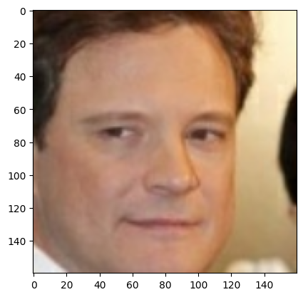
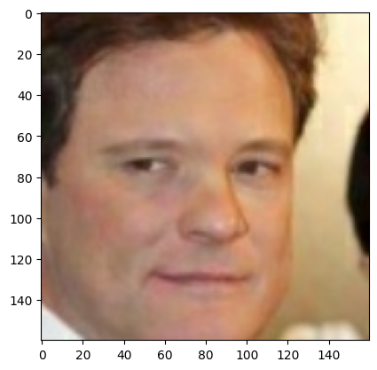
SimBA Attack
Original Image
Original label: 18
Confidence before attack: 0.9996
Adversarial Image
Adversarial label: 38
Confidence after attack: 0.1918

Slide 7
HopSkipJump Attack
The HopSkipJump attack is a powerful black-box attack designed to generate adversarial examples against a classifier. It was introduced by Jianbo et al. in 2019 as an advanced version of the boundary attack. This attack requires only the final class prediction from the classifier, making it suitable for scenarios where the attacker does not have access to the internal workings of the model.
The attack is a sophisticated method for creating adversarial examples with minimal information about the target classifier. It iteratively refines the adversarial examples by estimating the gradient and adjusting the perturbations to achieve the desired misclassification.
This attack can be implemented using the HopSkipJump function provided by the Adversarial Robustness Toolbox. By reviewing this function we can understand the internal working of the HopSkipJump attack.

Slide 8
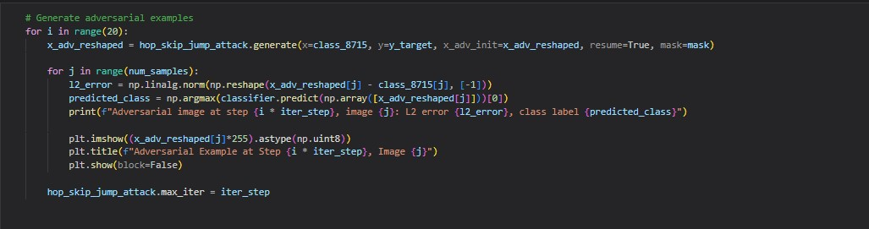
HopSkipJump Attack

Slide 9
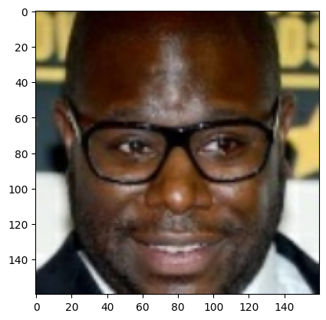
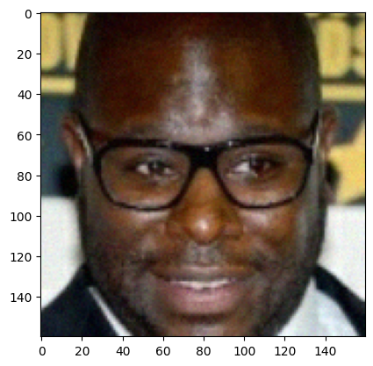
HopSkipJump Attack
Original Image
Original label: 8715
Confidence before attack: 0.9911
Adversarial Image
Adversarial label: 38
Confidence after attack: 0.1015

Slide 10
Boundary Attack
Boundary Attack is a black-box adversarial attack that starts with a large, easily detectable perturbation and iteratively reduces its size while maintaining its adversarial properties. The attack performs a random walk along the decision boundary of the model's classification regions, gradually refining the adversarial example to find the smallest possible perturbation that still causes misclassification.
The Boundary Attack is a powerful attack method that iteratively refines adversarial examples by perturbing inputs in directions orthogonal to the decision boundary and towards the target class. The attack is adaptive and stops when the perturbation is sufficiently small or the maximum number of iterations is reached.
This attack can be implemented using the Boundary function provided by the Adversarial Robustness Toolbox. By reviewing this function we can understand the internal working of the Boundary attack.

Slide 11
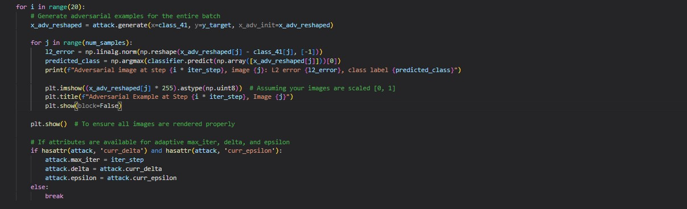
Boundary Attack

Slide 12
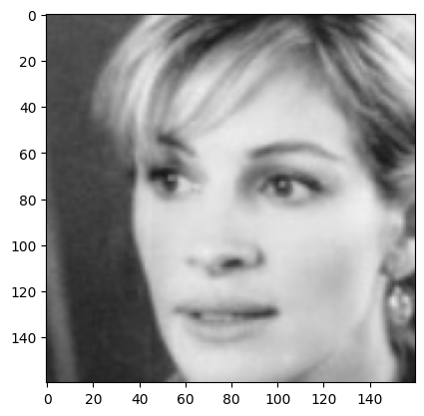
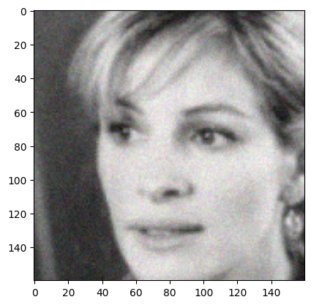
Boundary Attack
Original Image
Original label: 41
Confidence before attack: 0.9990
Adversarial Image
Adversarial label: 38
Confidence after attack: 0.1513

Slide 13
Square Attack

Slide 14
Conclusion

